Slide 1
PROJECT TITLE
CAPSTONE PROJECT
Presented By:
R.SURAJ
CARE COLLEGE OF ENGINEERING
MECHANICAL ENGINEERING

Slide 2
OUTLINE
Problem Statement
Proposed System/Solution
System Development Approach
Algorithm & Deployment
Result
Conclusion
Future Scope
References

Slide 3
Problem Statement
With the increasing reliance on digital transactions, credit card fraud has emerged as a significant threat to financial institutions and consumers worldwide. Fraudulent activities, including unauthorized transactions, stolen card information, and identity theft, result in substantial financial losses and undermine trust in the financial system. Detecting and preventing such fraudulent activities in real-time is crucial to safeguarding the interests of both cardholders and financial institutions.
The objective of this project is to develop an effective credit card fraud detection system capable of accurately identifying fraudulent transactions while minimizing false positives. The system should leverage advanced machine learning algorithms and data analytics techniques to analyze transactional data in real-time and flag suspicious activities for further investigation.

Slide 4
Proposed Solution
The proposed solution involves developing a machine learning model trained on historical transaction data to detect patterns indicative of fraud. Techniques such as anomaly detection, supervised learning, or a combination thereof will be employed to identify suspicious transactions. The model will be continuously updated to adapt to emerging fraud patterns and improve detection accuracy over time.

Slide 5
System Approach
Data Collection and Preprocessing
Imbalanced Data Handling
Model Selection and Training
Real-Time Monitoring
Ensemble Methods and Anomaly Detection
Continuous Model Evaluation and Improvement
Collaboration with Fraud Analysts
Compliance and Privacy Considerations
Documentation and Reporting

Slide 6
Algorithm & Deployment
The Local Outlier Factor or LOF algorithm is an unsupervised anomaly detection method. It computes the local deviation of a given a data point with respect to its neighbours. Local Outlier Factor considers as outliers the samples that have a substantially lower density than their neighbours .
The Isolation Forest ‘isolates’ observations by randomly selecting a feature and then randomly selecting a split value between the maximum and minimum values of the selected feature.
Since recursive partitioning can be represented by a tree structure, the number of splittings required to isolate a sample is equivalent to the path length from the root node to the terminating node.
This path length, averaged over a forest of such random trees, is a measure of normality and our decision function.
Random partitioning produces noticeably shorter paths for anomalies. Hence, when a forest of random trees collectively produce shorter path lengths for particular samples, they are highly likely to be anomalies.

Slide 7
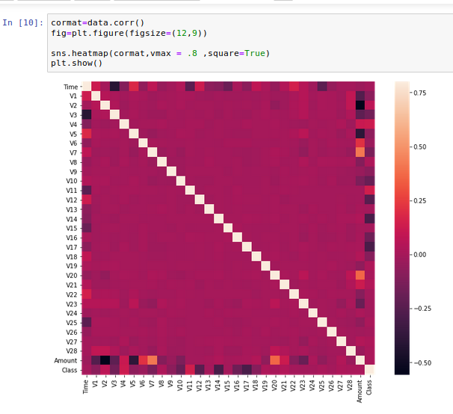
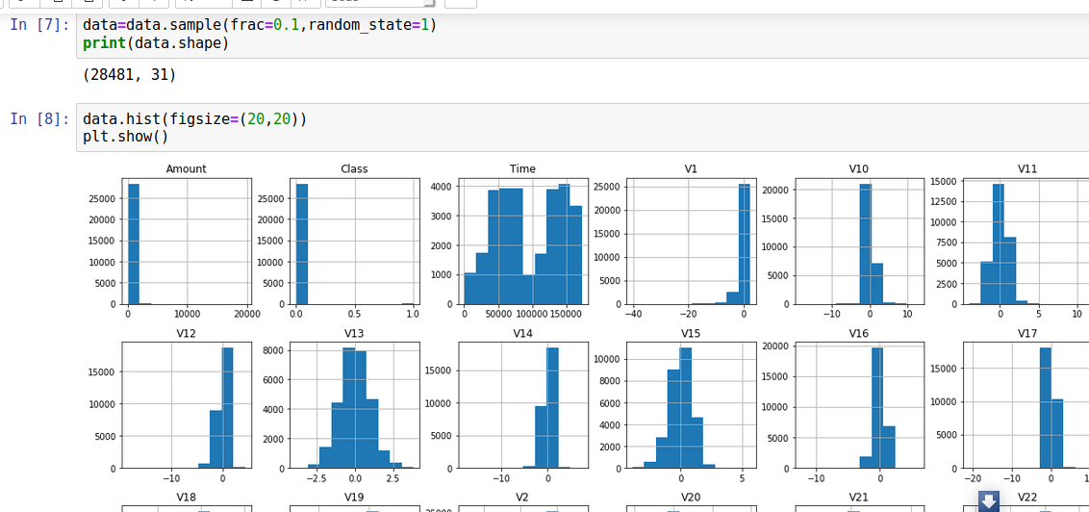
Result

Slide 8
Conclusion
The implementation of a credit card fraud detection system is paramount in safeguarding the interests of both financial institutions and consumers. By leveraging advanced algorithms and modern deployment techniques, financial organizations can effectively combat the rising threat of fraudulent activities in credit card transactions.
The adoption of algorithms such as XGBoost, LightGBM, or CatBoost enables the accurate identification of fraudulent transactions while minimizing false positives. These algorithms excel in handling large-scale, imbalanced datasets characteristic of credit card transaction data, providing a robust foundation for fraud detection.
In conclusion, a well-designed credit card fraud detection system, powered by advanced algorithms and deployed using modern techniques, plays a crucial role in combating fraudulent activities, safeguarding financial assets, and upholding trust in the credit card industry. Through proactive measures and continuous improvement, financial institutions can stay ahead of evolving fraud tactics and ensure a secure environment for cardholders worldwide.

Slide 9
Future scope
The future scope of credit card fraud detection lies in the integration of cutting-edge technologies such as advanced machine learning algorithms, big data analytics, and behavioral biometrics to develop more accurate, efficient, and proactive fraud detection systems. Leveraging real-time processing capabilities and AI-powered solutions, future fraud detection systems will be capable of detecting emerging fraud trends, preemptively identifying suspicious activities, and mitigating risks in a timely manner. Collaborative networks among financial institutions, coupled with blockchain technology for secure transactions and transparent fraud data sharing, will enhance the industry's collective efforts in combating fraudulent activities. Furthermore, the implementation of explainable AI (XAI) techniques and adherence to regulatory compliance standards will ensure transparency, accountability, and customer trust in fraud detection processes. Overall, the future of credit card fraud detection is poised to revolutionize the financial industry, enabling more robust security measures and safeguarding the interests of both cardholders and financial institutions alike.

Slide 10
References
Visit https://www.irjet.net/archives/V5/i11/IRJET-V5I11304.pdf
Visit https://acadpubl.eu/jsi/2018-118-7-9/articles/7/31.pdf
Visit https://arxiv.org/pdf/1811.02196.pdf
Visit https://towardsdatascience.com/anomaly-detection-with-isolation-forest-visualization-23cd75c281e2

Slide 11
THANK YOU

